Slide 1
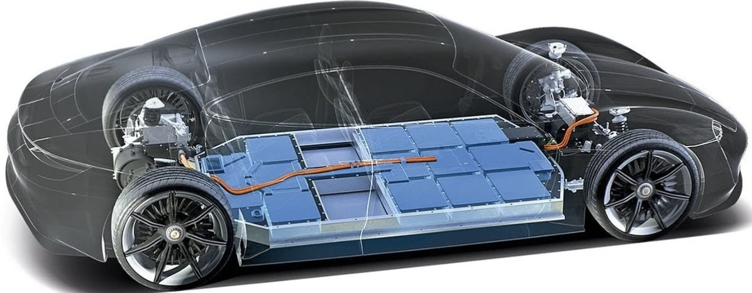
EV BATTERY EXPLORER
“RESPONSIVE STATIC WEBSITE FOR EV EDUCATION”

Slide 2
Project overview and goals
Overview: Creating an educational, responsive website that educates the users about EV battery technologies using HTML,CSS and JavaScript
What was Achieved:
Visual Design Highlights:
Clean, Modern, typography and layout
Uniform color Scheme and branding
Simple Scroll down interface for users
High Quality Visualization

Slide 3
Project overview and goals
Key Website Features
6 different batteries covered
Interactive expandable scroll down cards
Mobile-responsive Design
4. Smooth animations for enhanced user expert

Slide 4
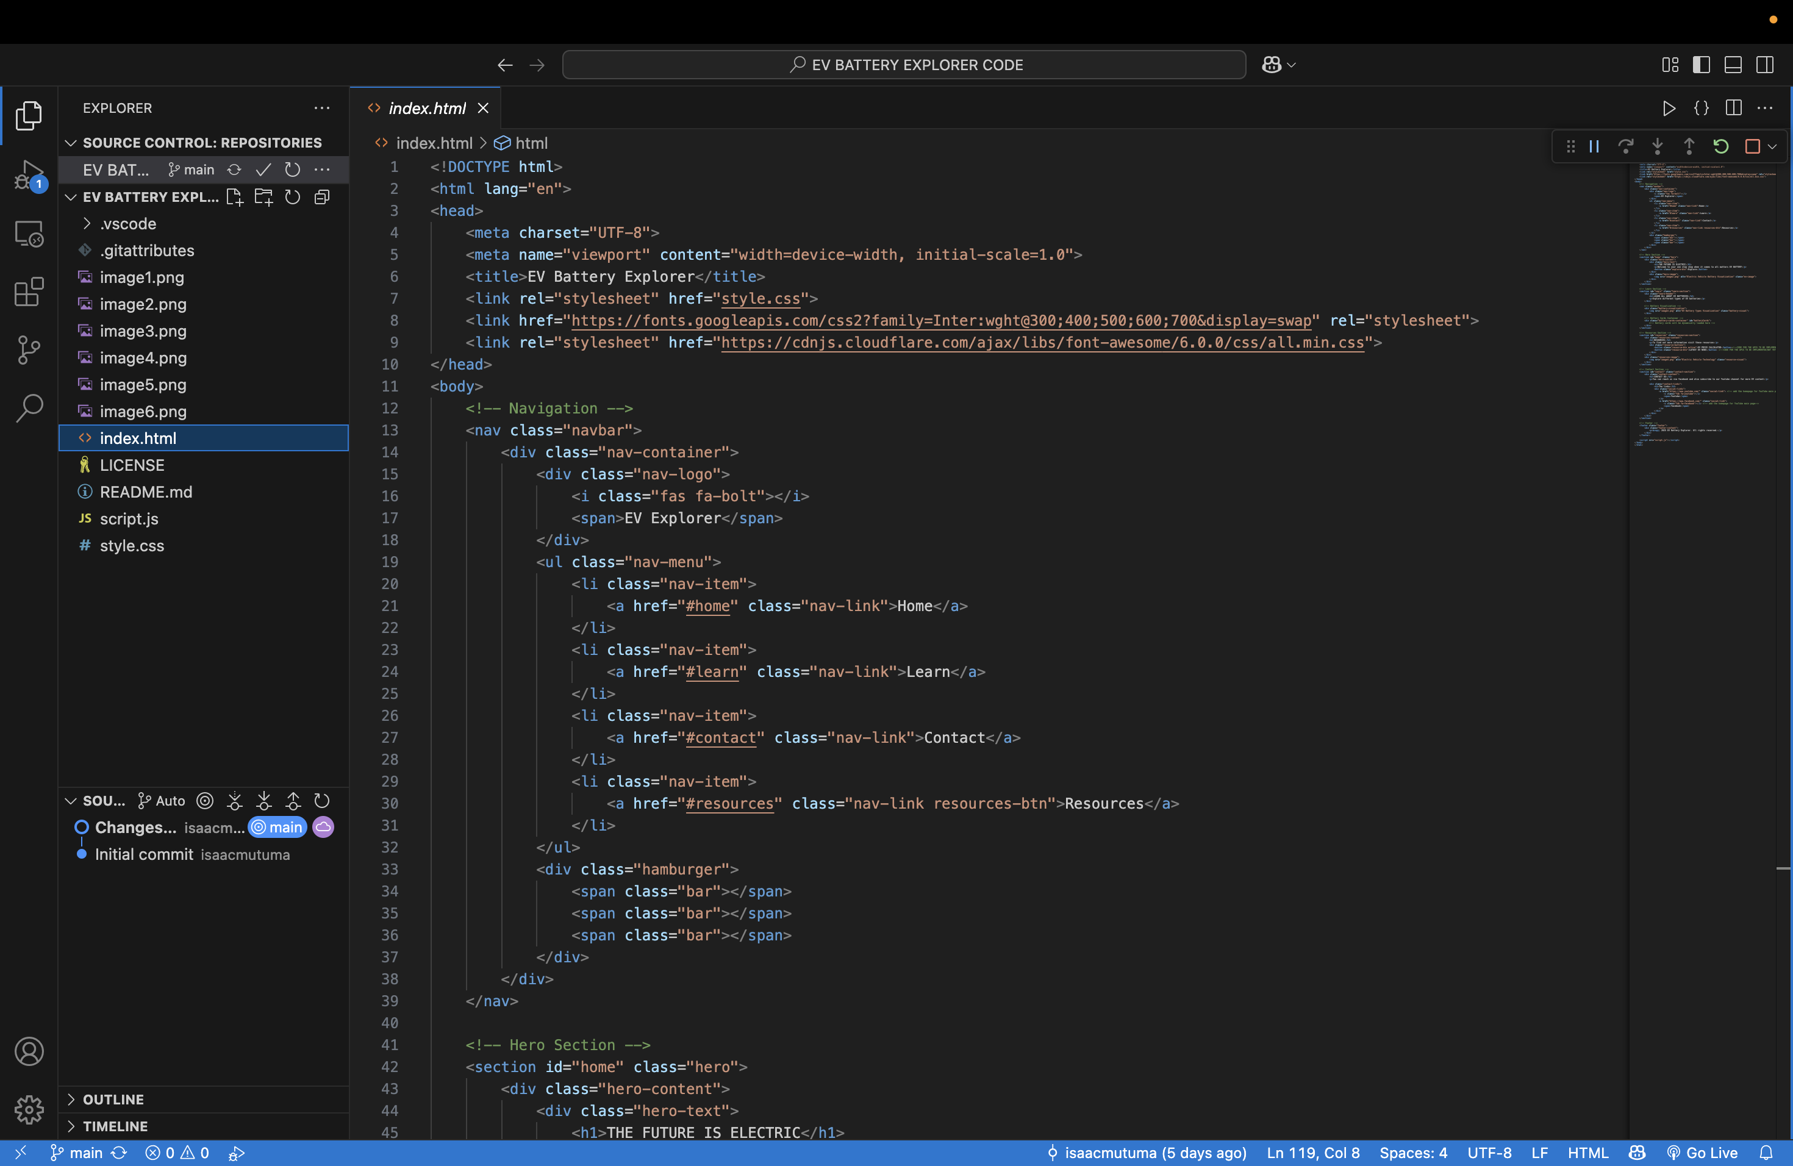
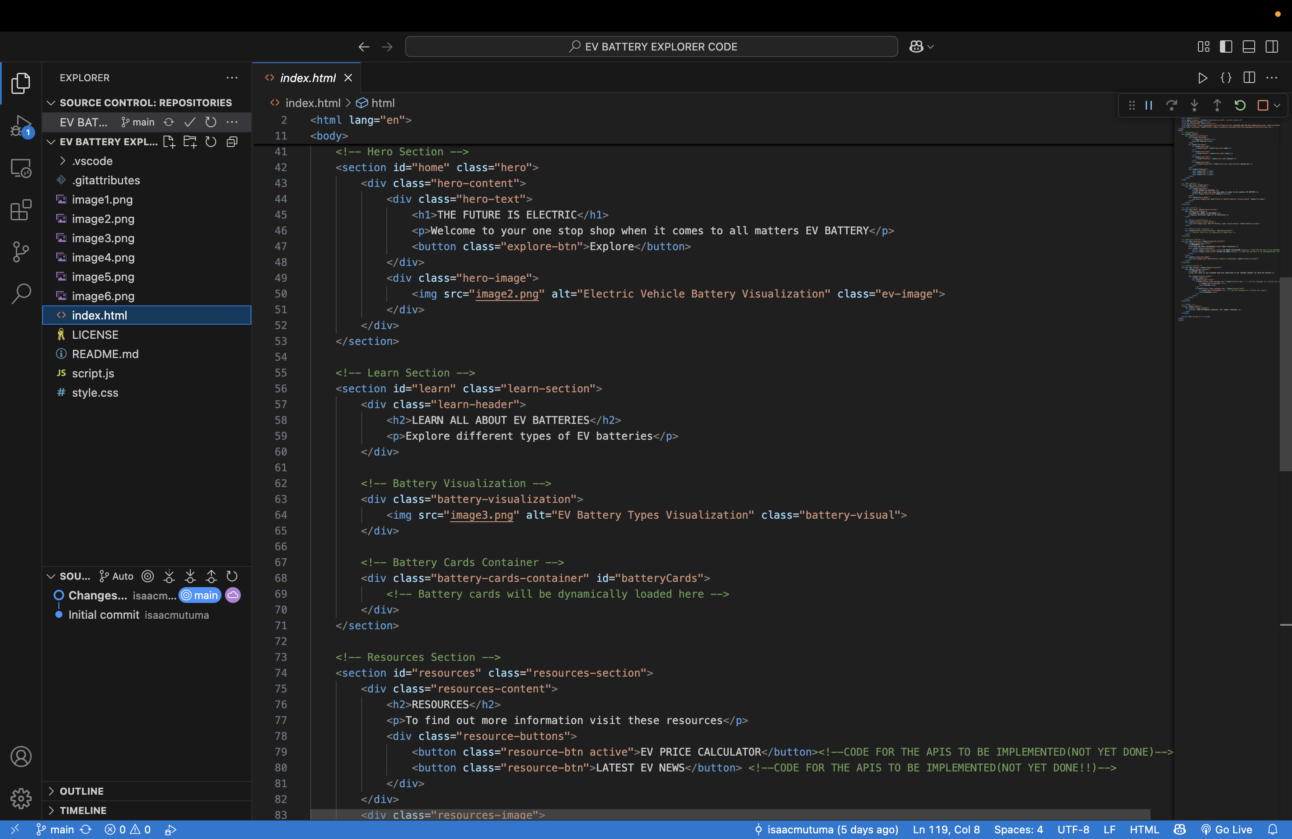
Technology stack -HTML
EV BATTERY EXPLORER
Sample HTML code used for sections, buttons, links, images and main website info

Slide 5
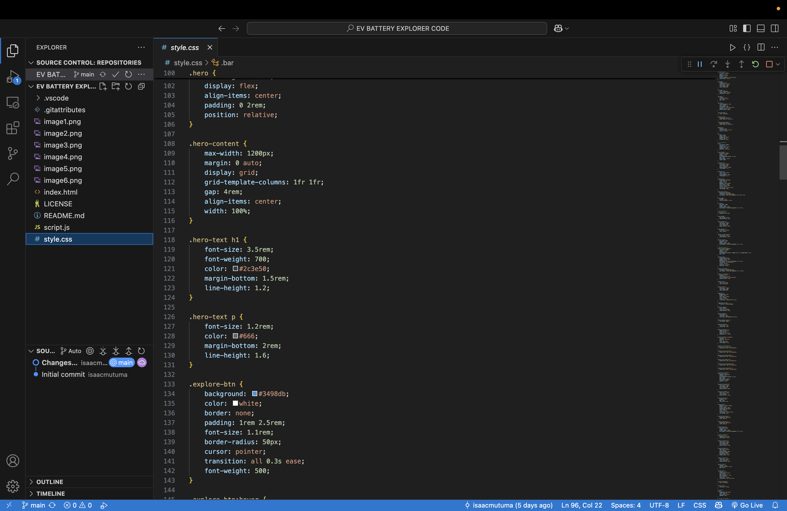
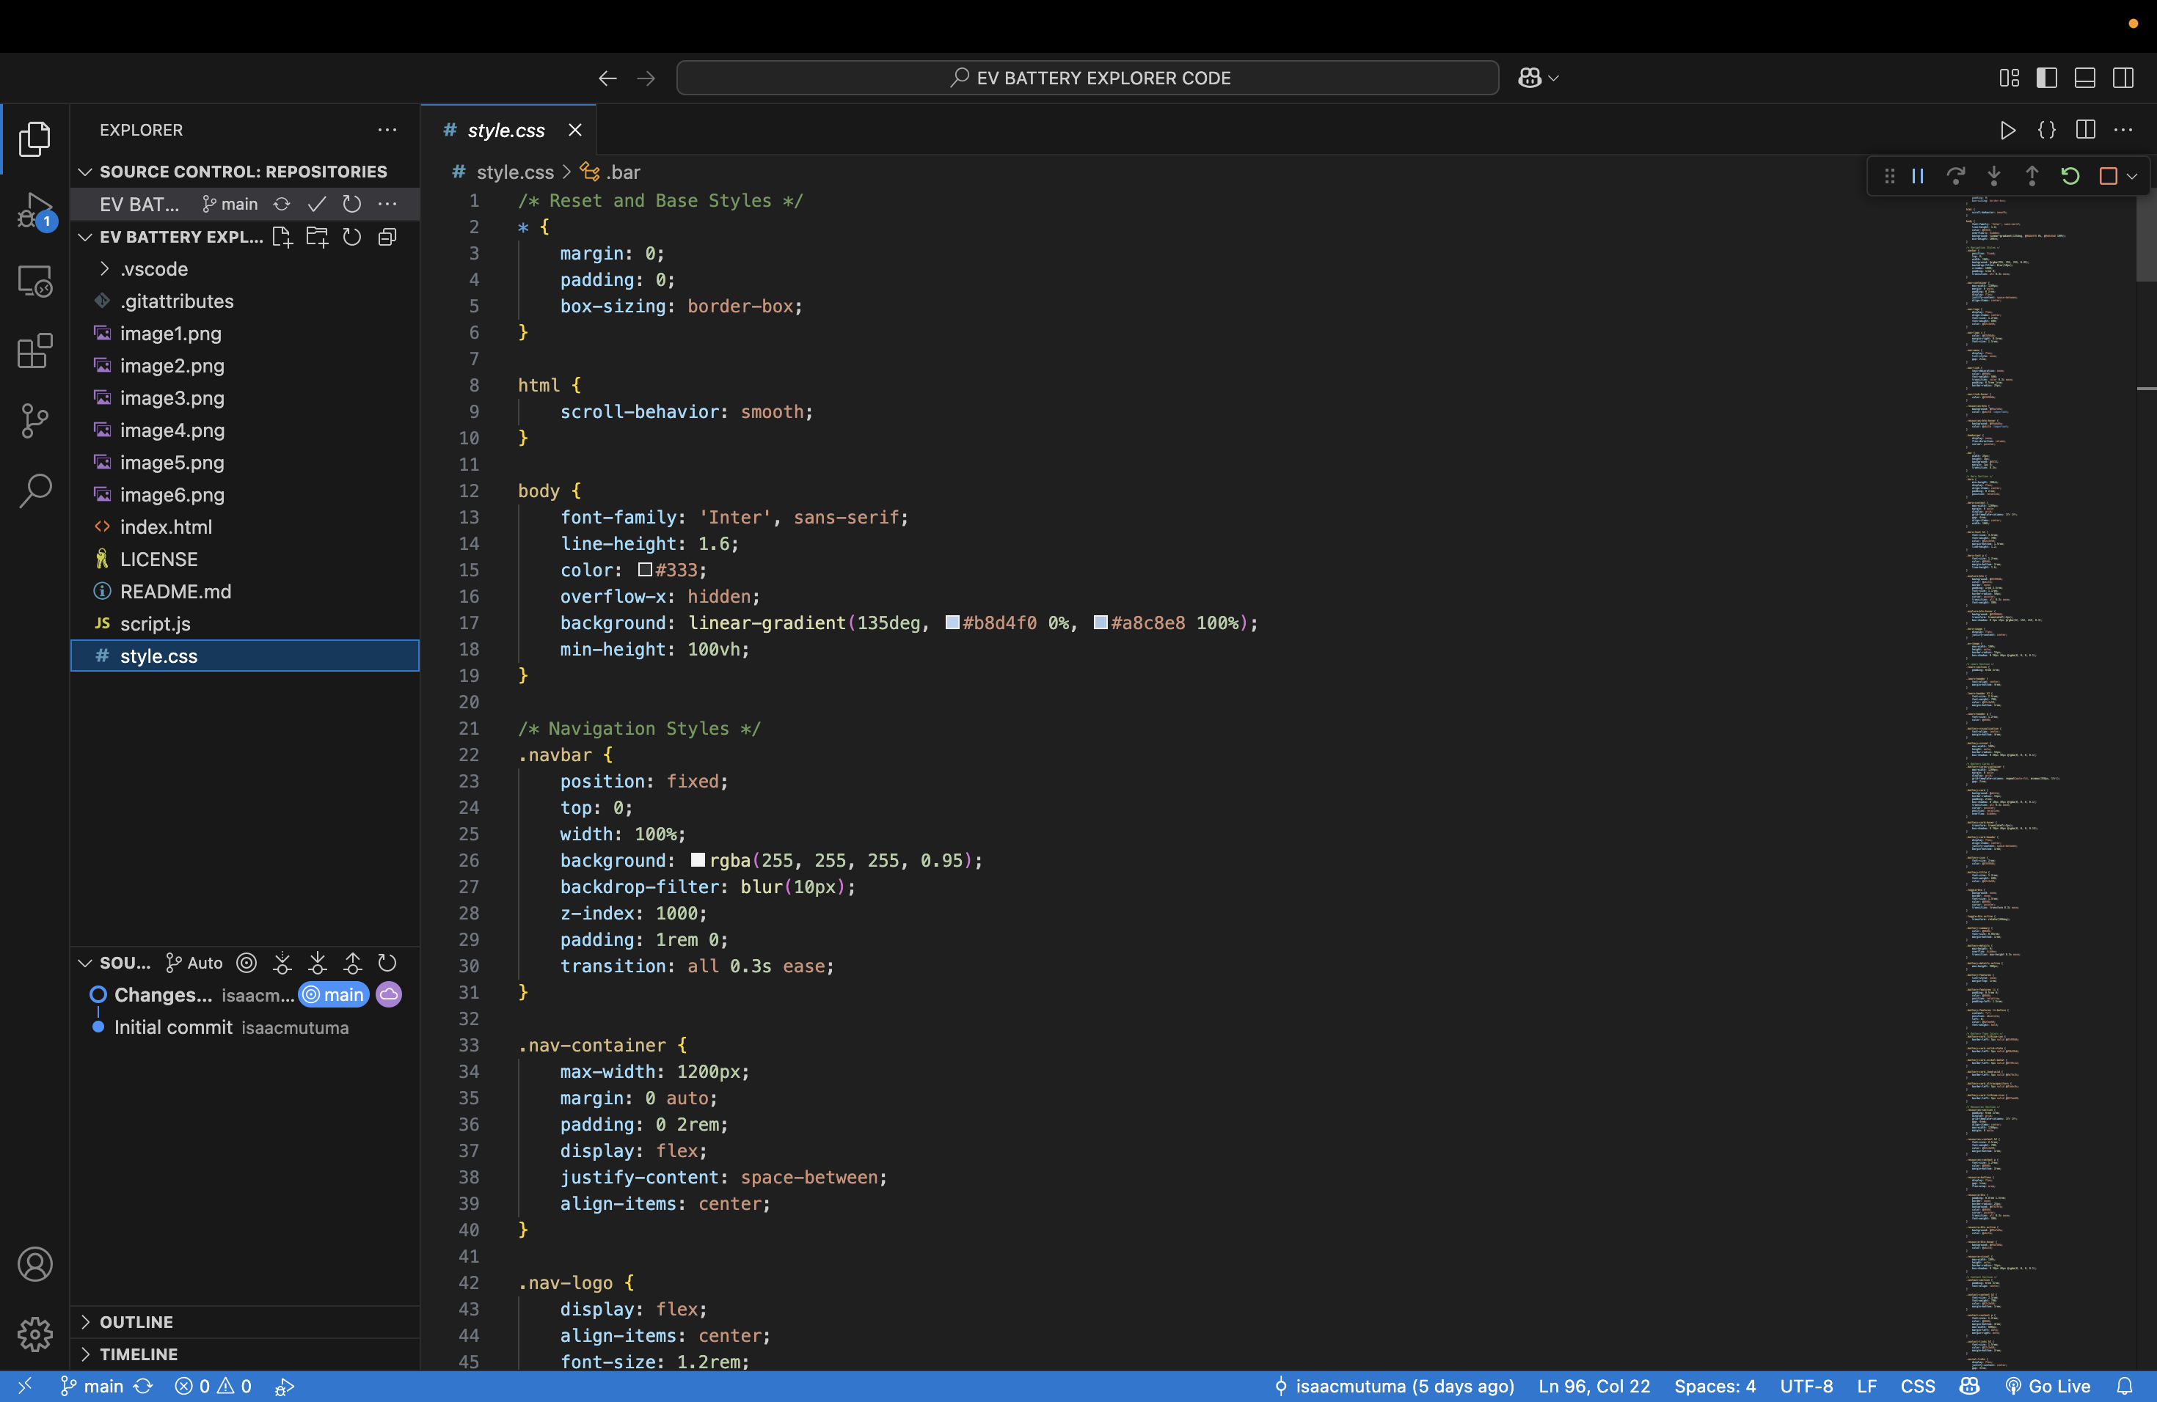
Technology stack -CSS
EV BATTERY EXPLORER
CSS imports inter font family from google fonts and font awesome for logos, buttons, menu icon, and battery type icons

Slide 6
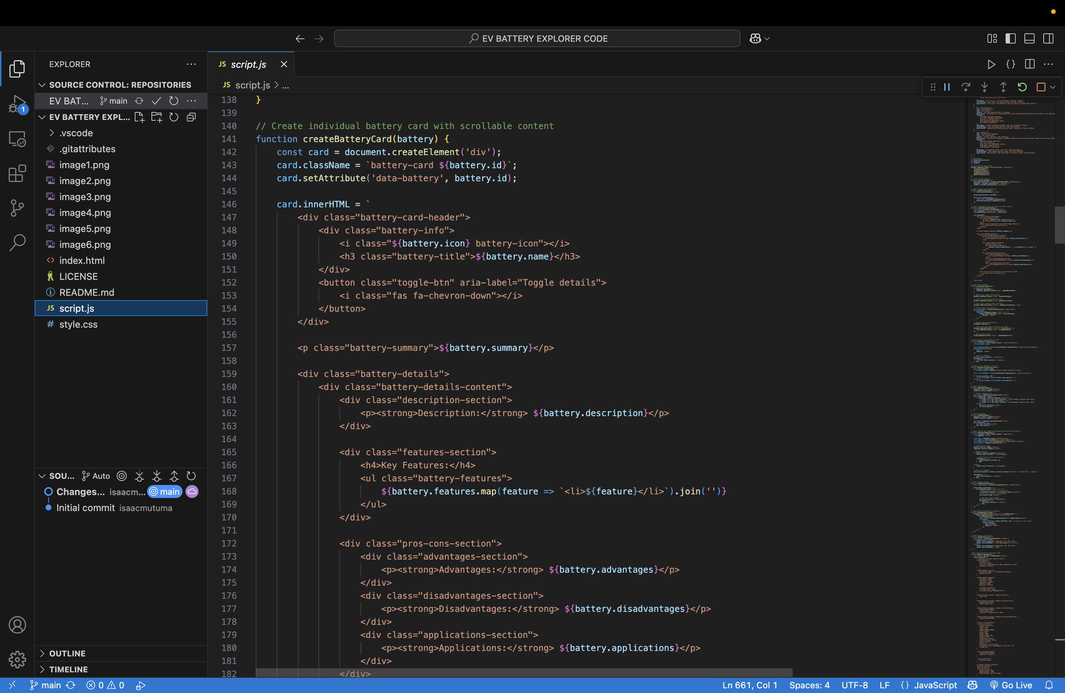
Technology stack -JavasCRIPT
EV BATTERY EXPLORER
Data Management: Contains info on batteries
Dynamic Content Automatically interactive battery card information from the data objects.
Expandable cards- Show detailed information and hover effects
Scrollable content- The expanded cards are scrollable with smooth animations
Mobile navigation- A hamburger menu for mobile users

Slide 7
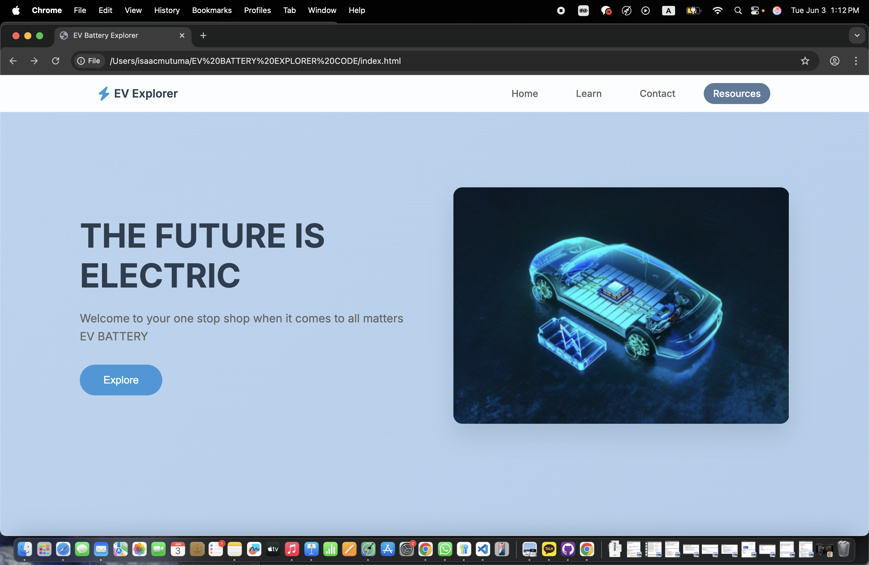
Homepage hero Page
EV BATTERY EXPLORER
Built primarily with HTML and CSS. Simple layout with a landing page image and nav bar for smooth scrolling

Slide 8
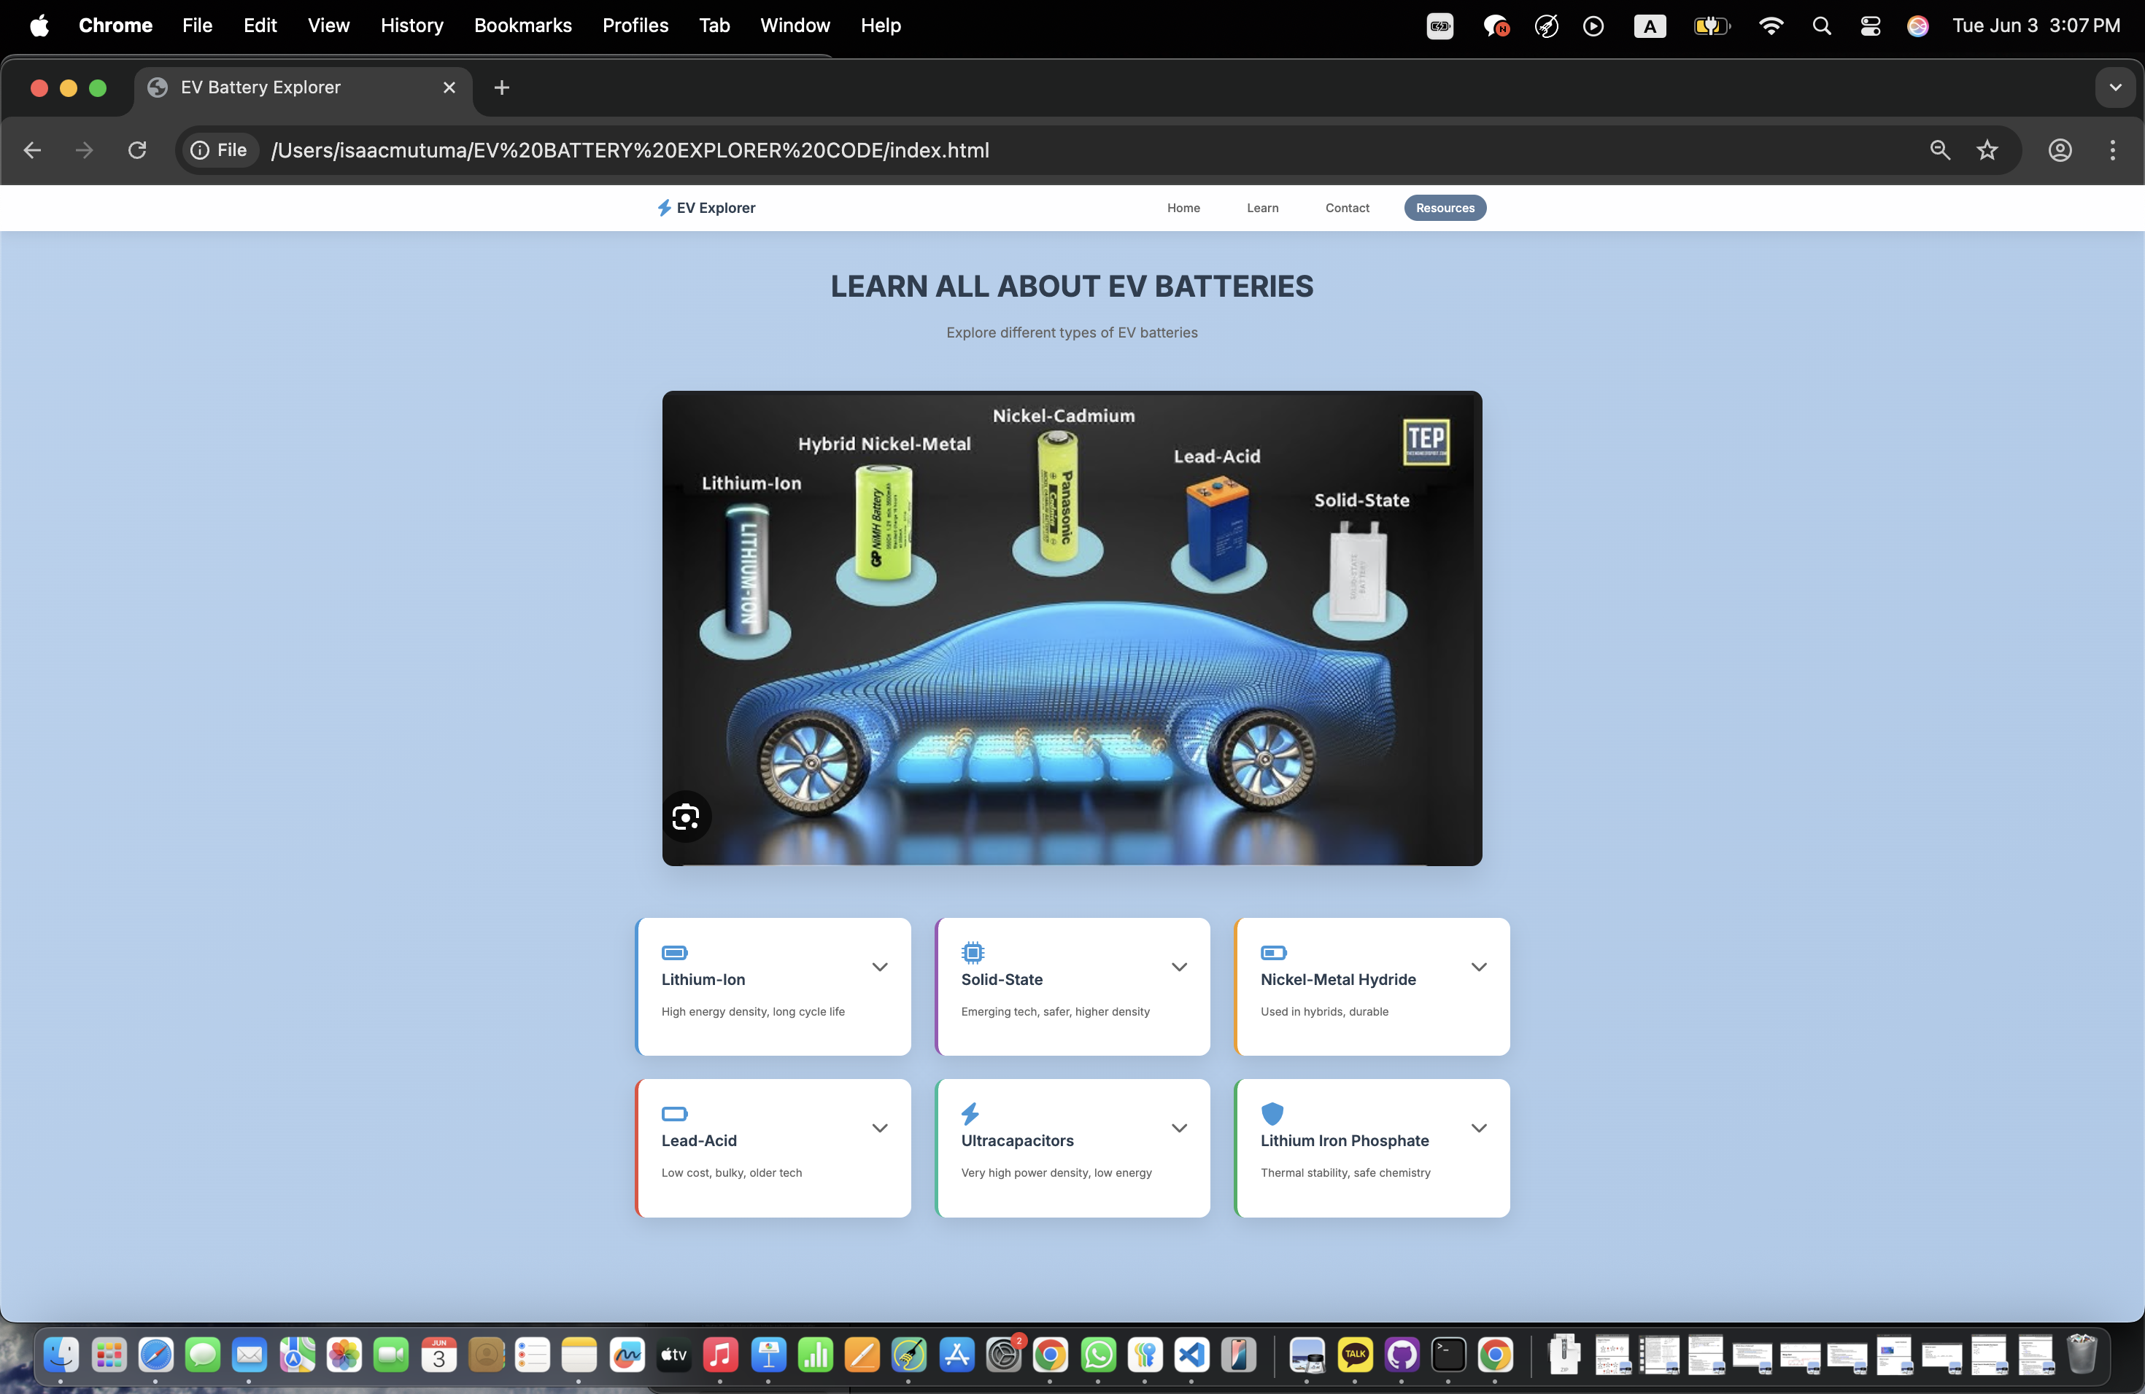
MAIN PAGE-LEARN
EV BATTERY EXPLORER
Learn
Contains the grid layout of the cards in a collapsed state.

Slide 9
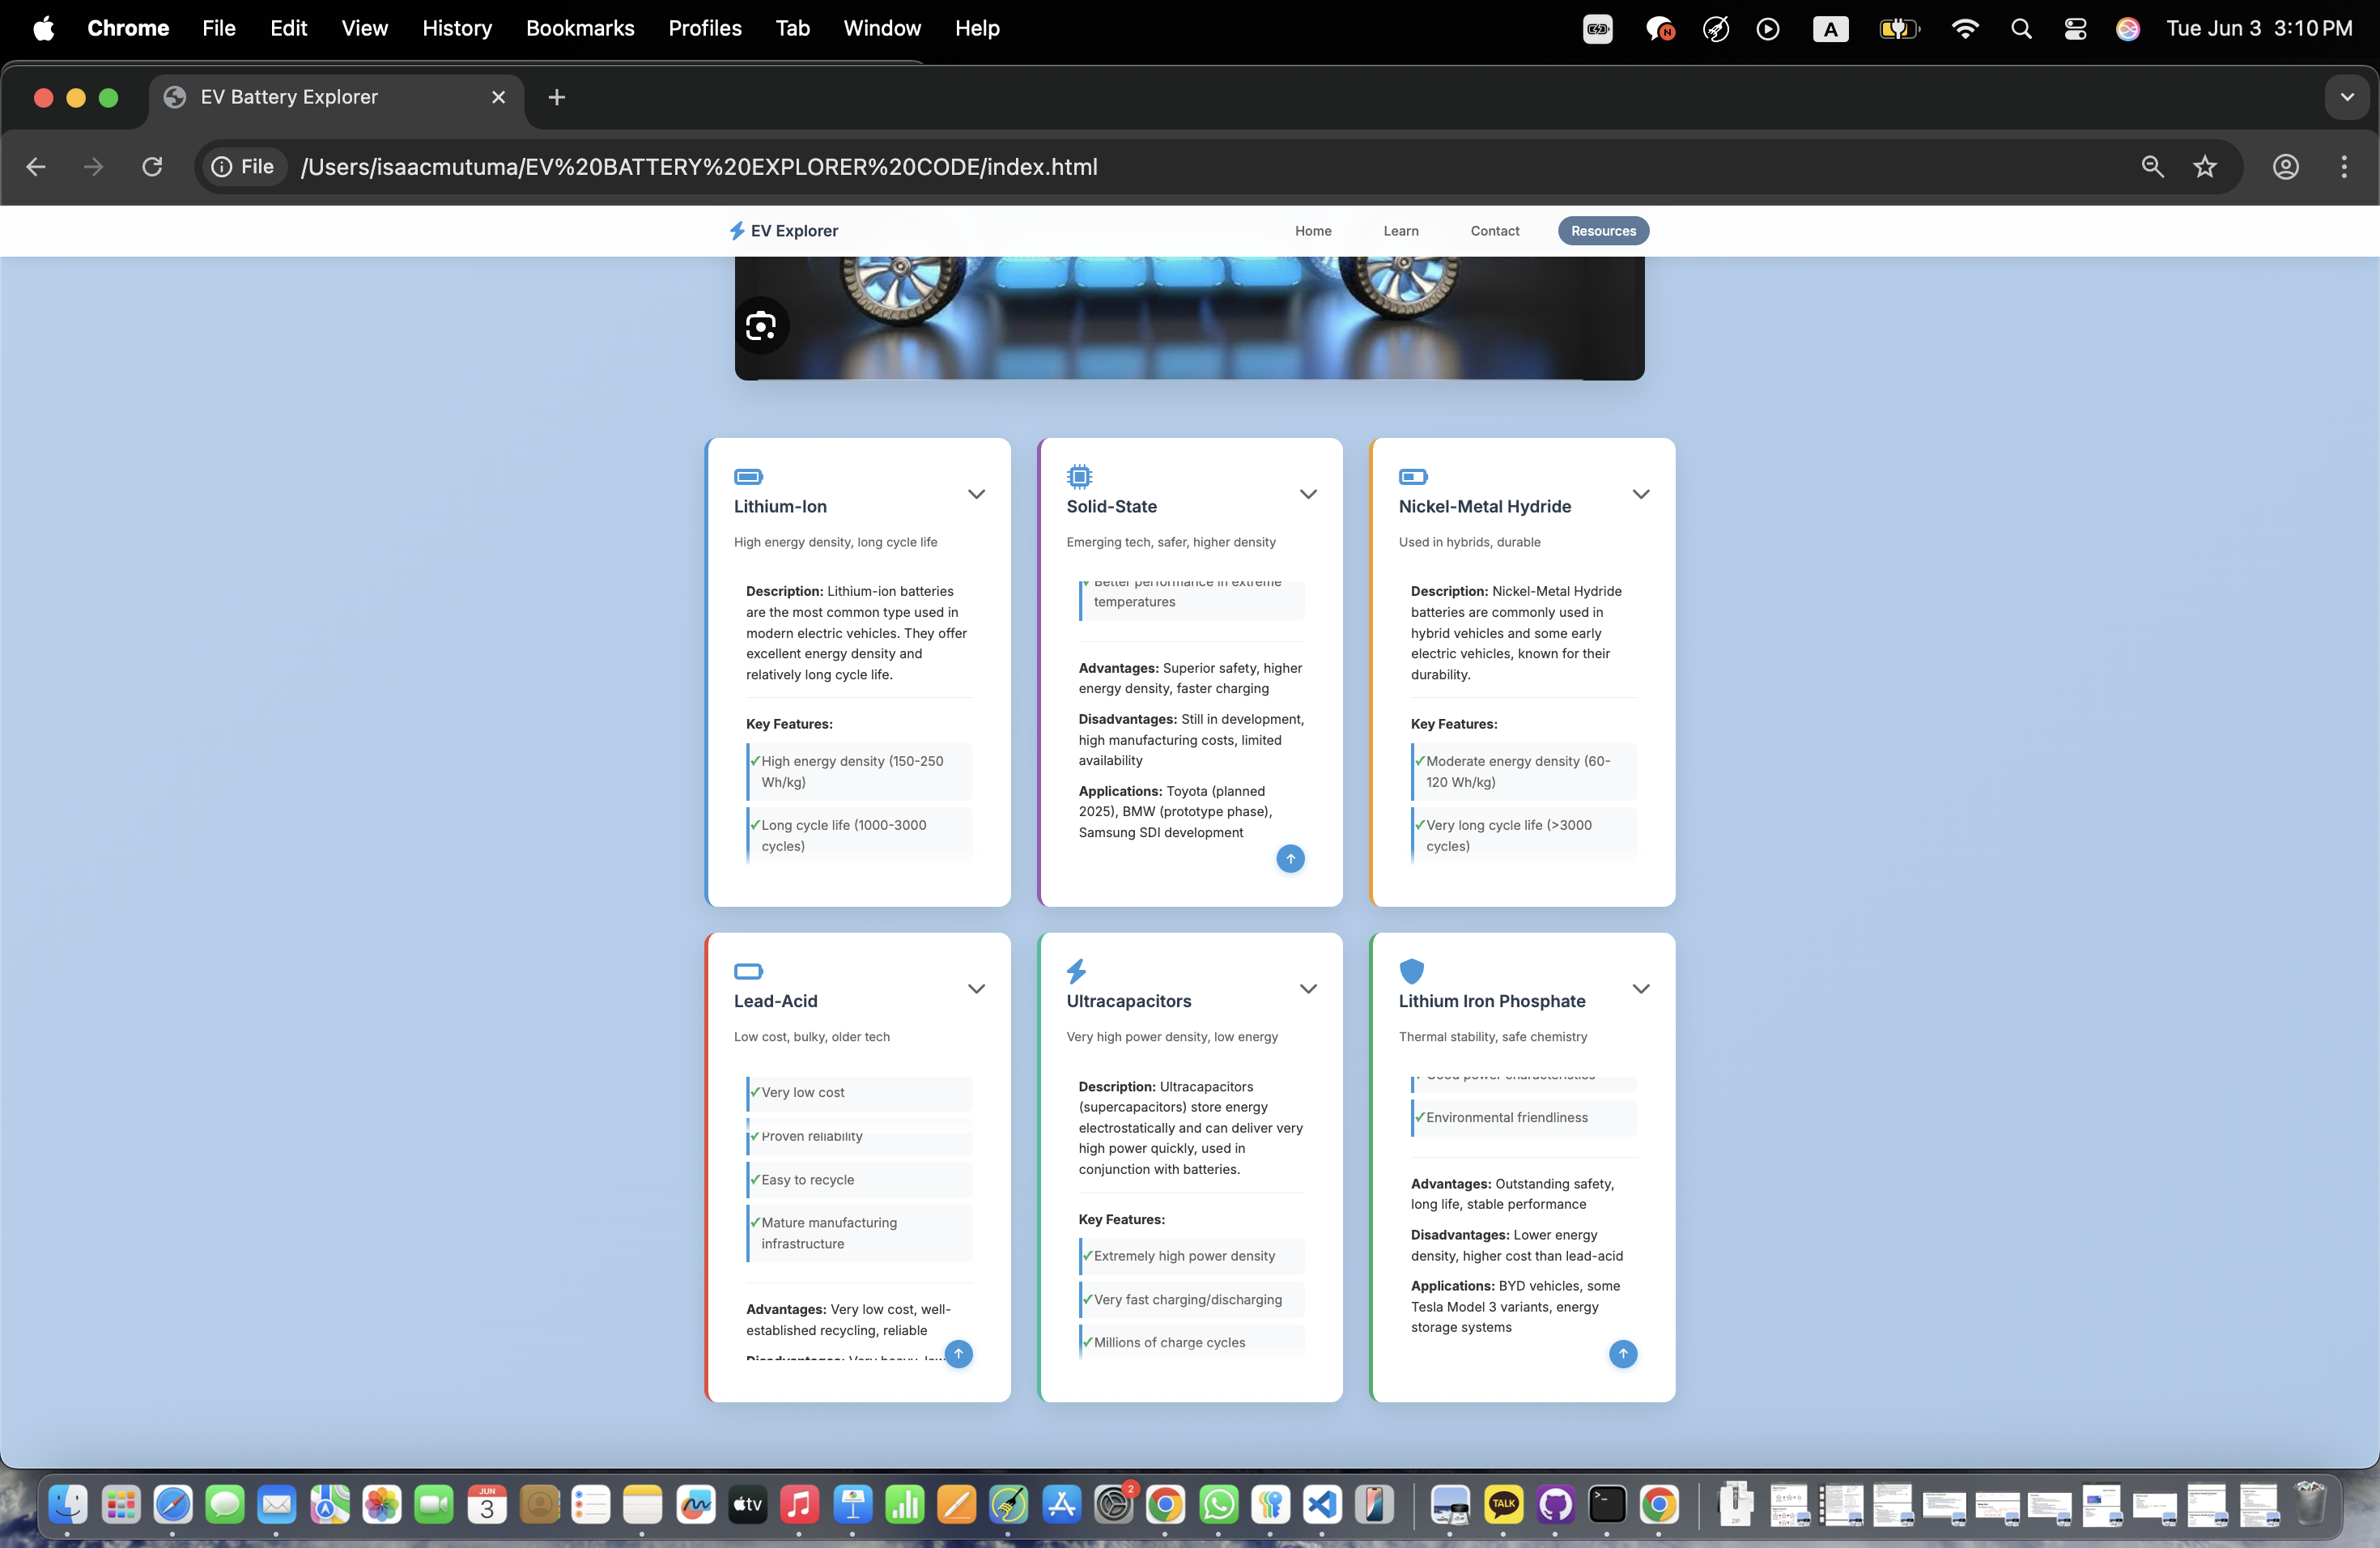
BATTERY CARD information design
EV BATTERY EXPLORER
Description section
Key features of each battery type
Advantages and disadvantages
Real - world applications
Handle scroll to the top of the cards button
Hover effect on cards, and button scroll up

Slide 10
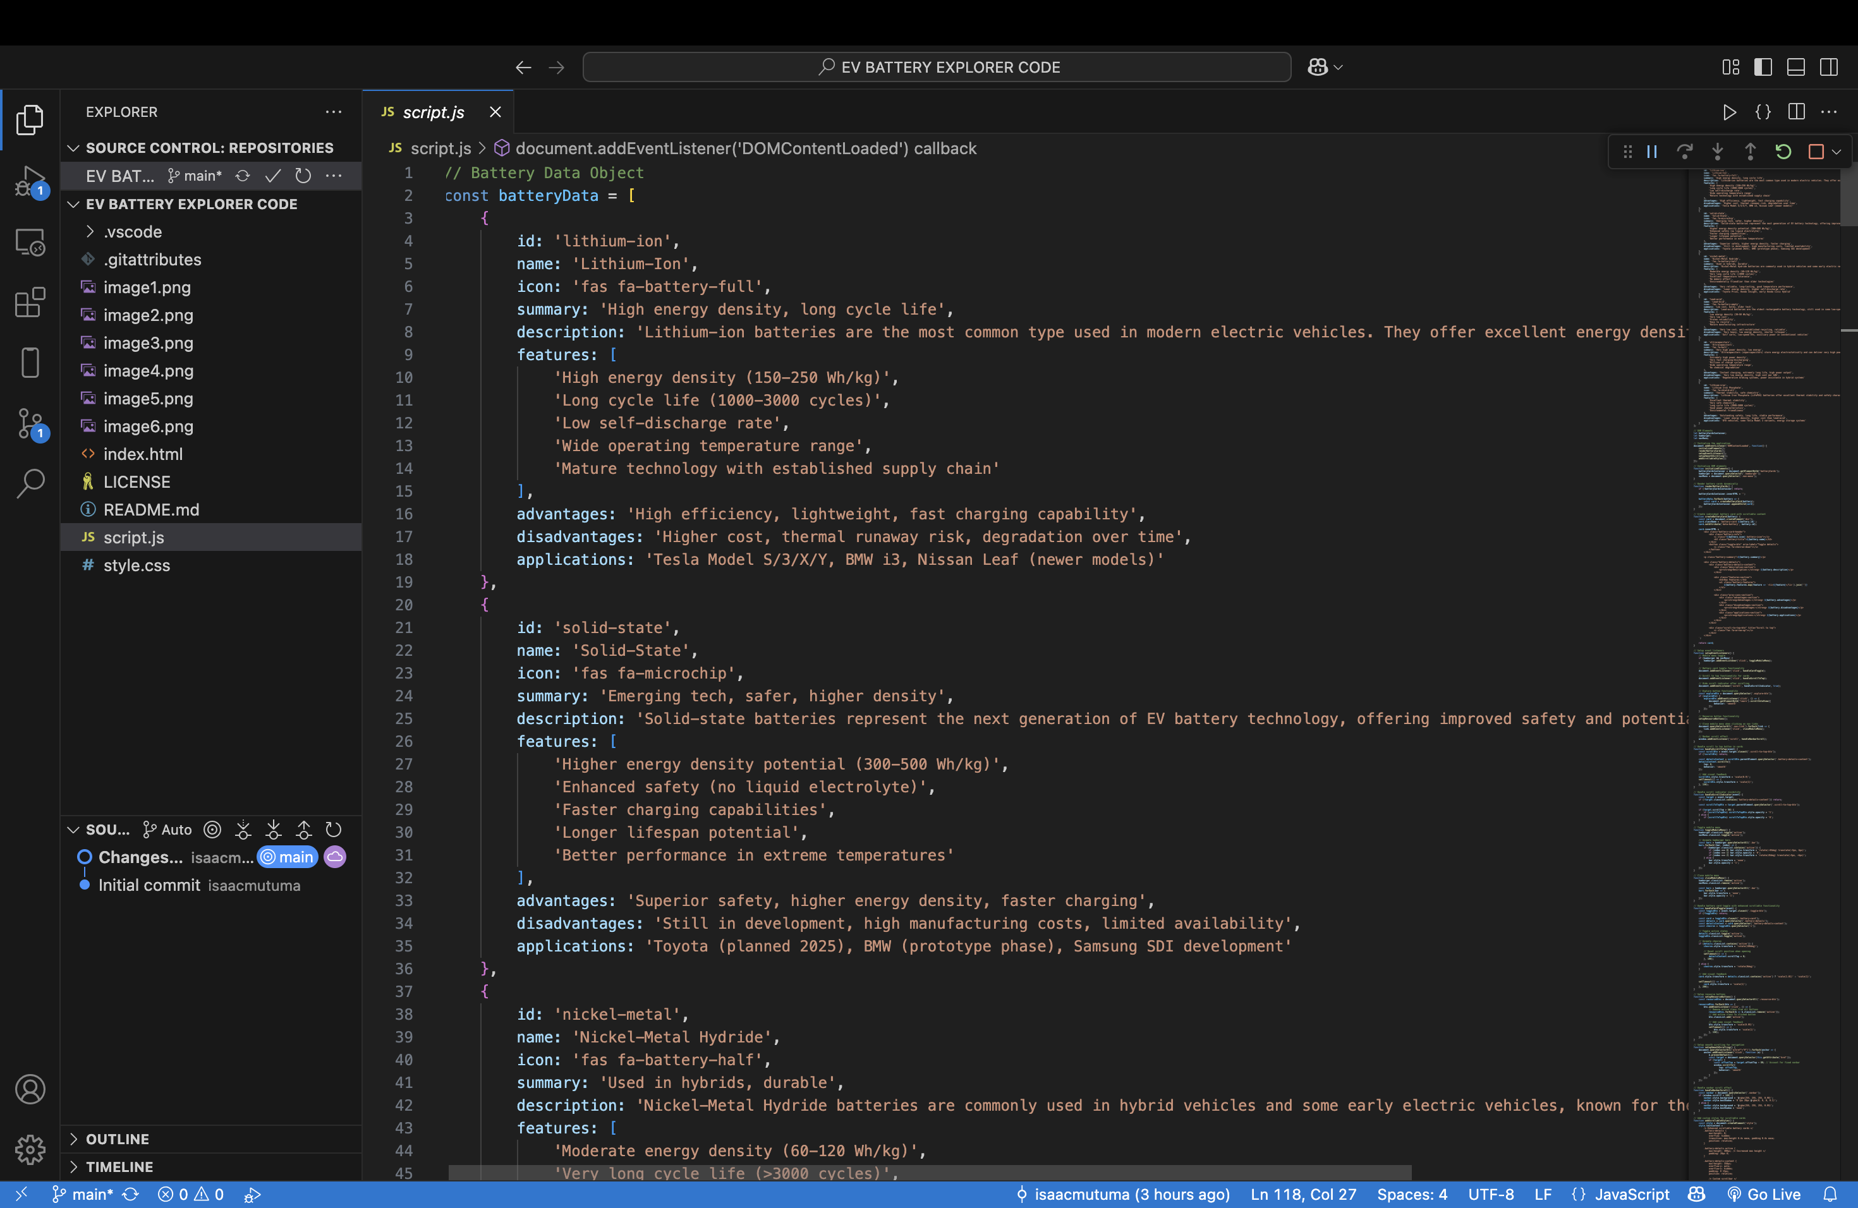
CHALLENGES FACED
EV BATTERY EXPLORER
Creating a scrollable content within the fixed height of the cards- Implemented a scrollbar(CSS) scroll handing(JS)
Managing complex states with javascript-efficient DOM manipulation(every state change needed manual updating the DOM elements)

Slide 11
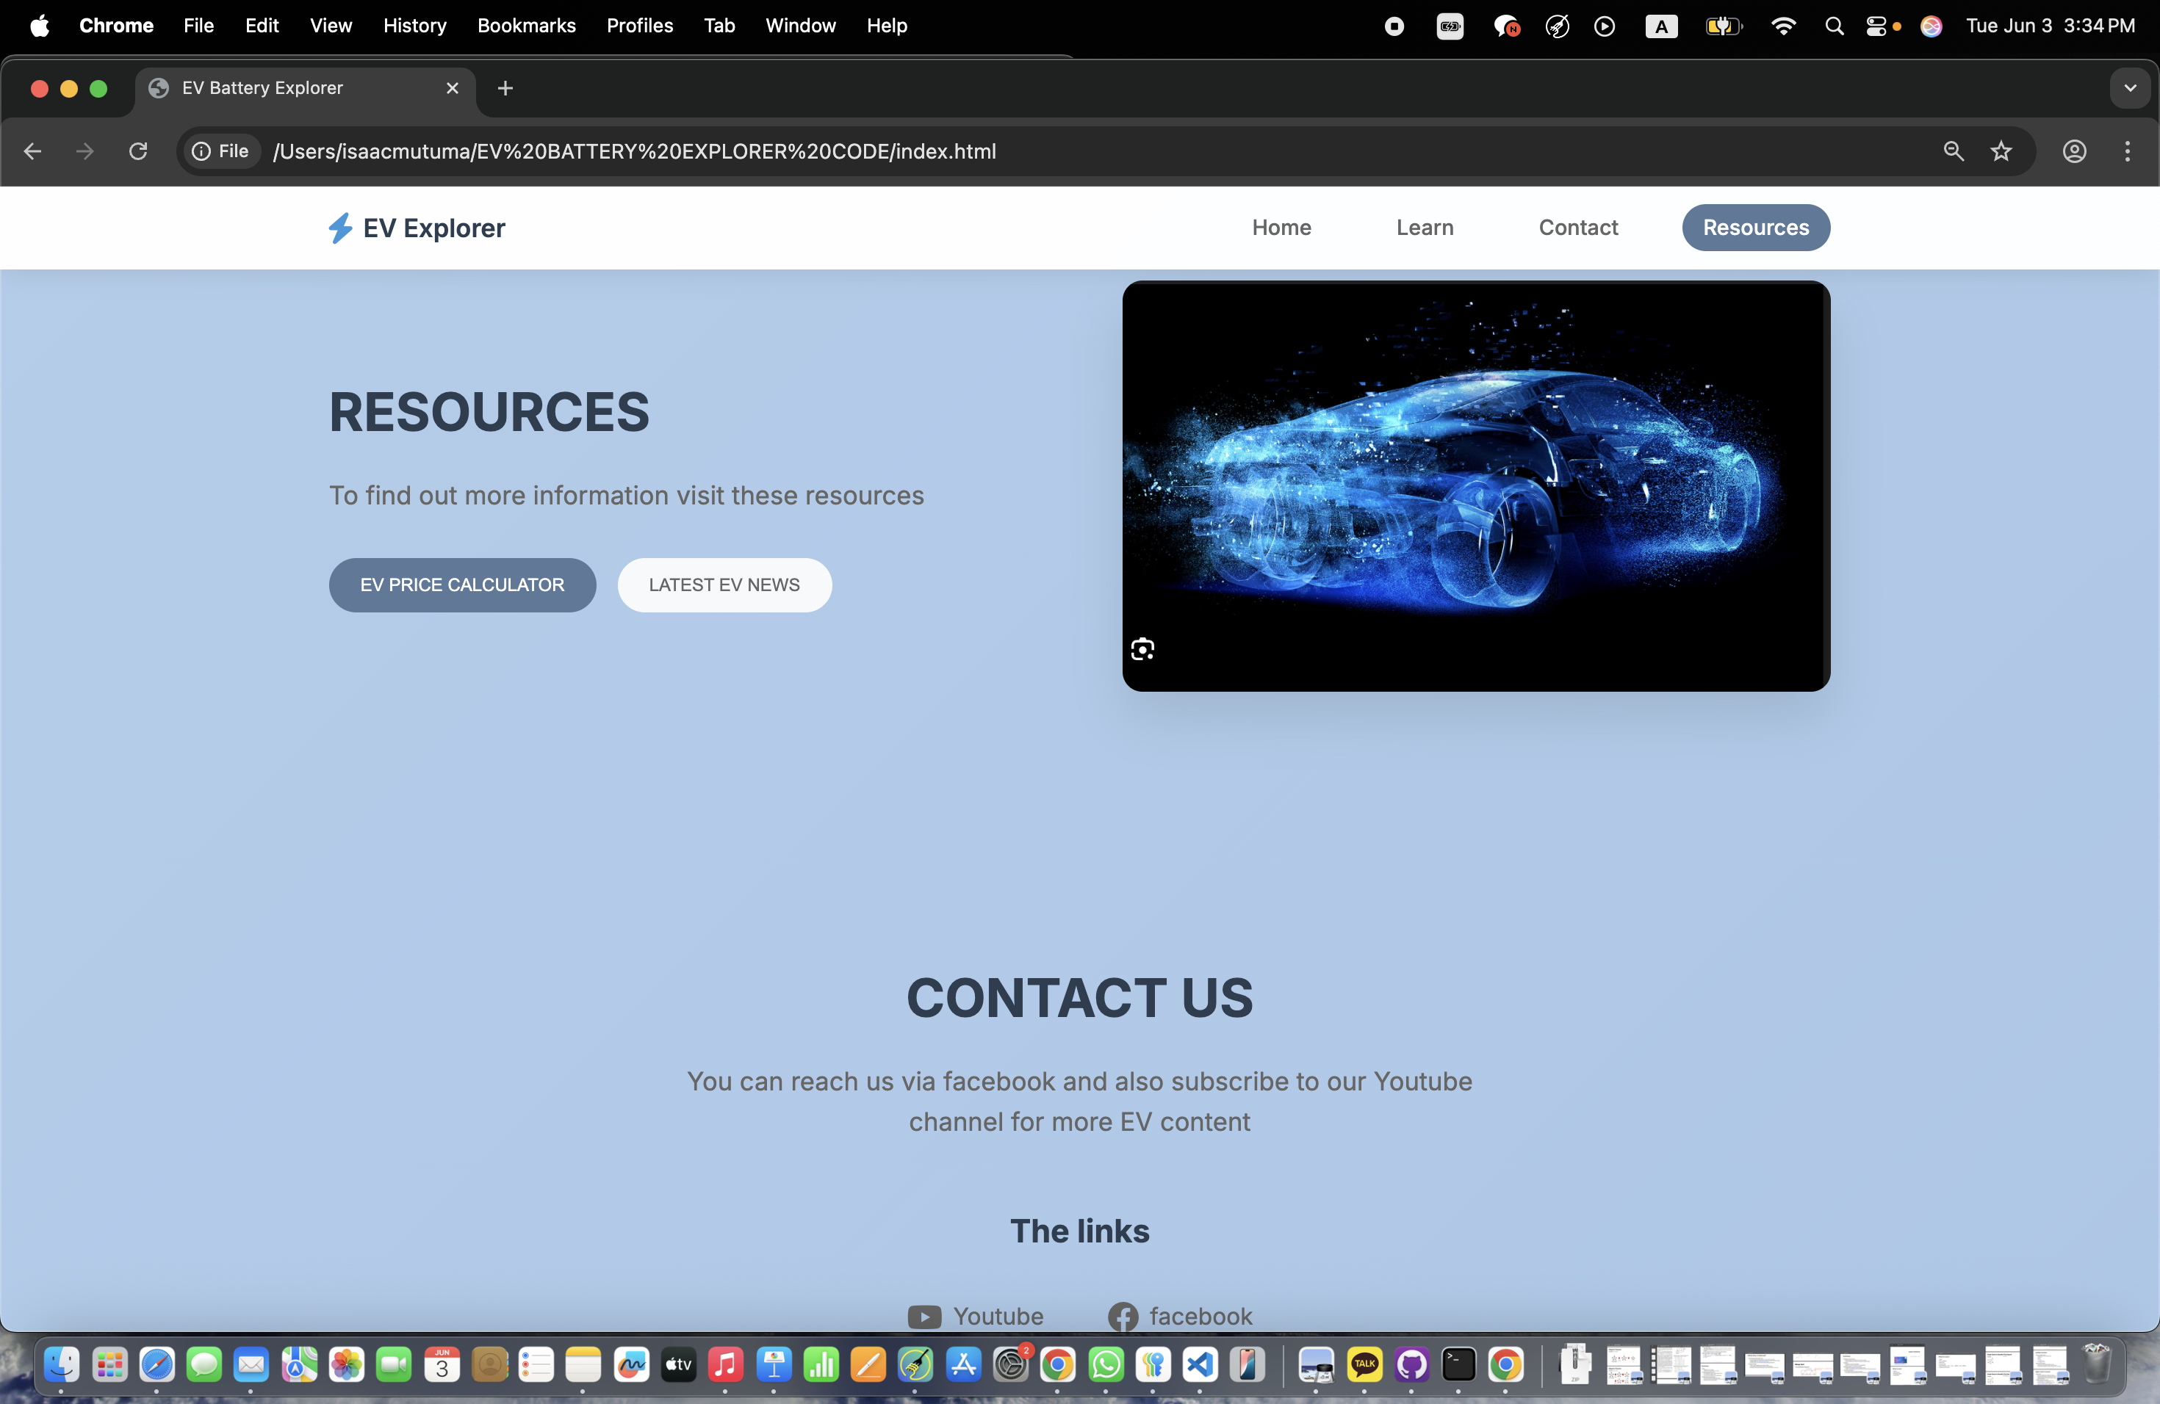
SHORTCOMINGS AND FUTURE ENHANCEMENTS
EV BATTERY EXPLORER
Api integration feature for real time EV prices and latest news
Search and filter function(not fully implemented)
Battery comparison tool

Slide 12
THE END<3

